Slide 1

IT Essentials (CompTIA A+) Ch. 19
Display Technologies

Slide 2
Overview
In this chapter, you will learn how to:
Explain how video displays work
Select the proper video card
Install and configure video
Troubleshoot basic video problems
Notes:
2

Slide 3
Introduction
Video – complex interaction among numerous parts of personal computing devices, all designed to put a picture on a screen
The monitor or video display shows what’s going on with programs and the operating system.
The video card or display adapter handles communication between the CPU and the monitor display.
Notes:
3

Slide 4
Video Displays
There are two types of video displays for computing devices:
LCD – used on modern personal computers
Projector – found in boardrooms and classrooms
PCs and Macs originally used a CRT monitor.
Some CRT terminology still applies to modern displays.

Slide 5
CRT Monitors
All CRT monitors have a cathode ray tube (CRT), which is a vacuum tube.
One end of this tube is a slender cylinder that consists of three electron guns.
The wide end of the CRT is the display screen.
Notes:
5

Slide 6
CRT Monitors
Power applied to the electron guns generates a stream of electrons.
This stream is subjected to a magnetic field generated by a ring of electromagnets called a yoke.
The phosphor coating releases energy as visible light when struck by the electrons.
Persistence – phosphors continue to glow momentarily after being struck.

Slide 7
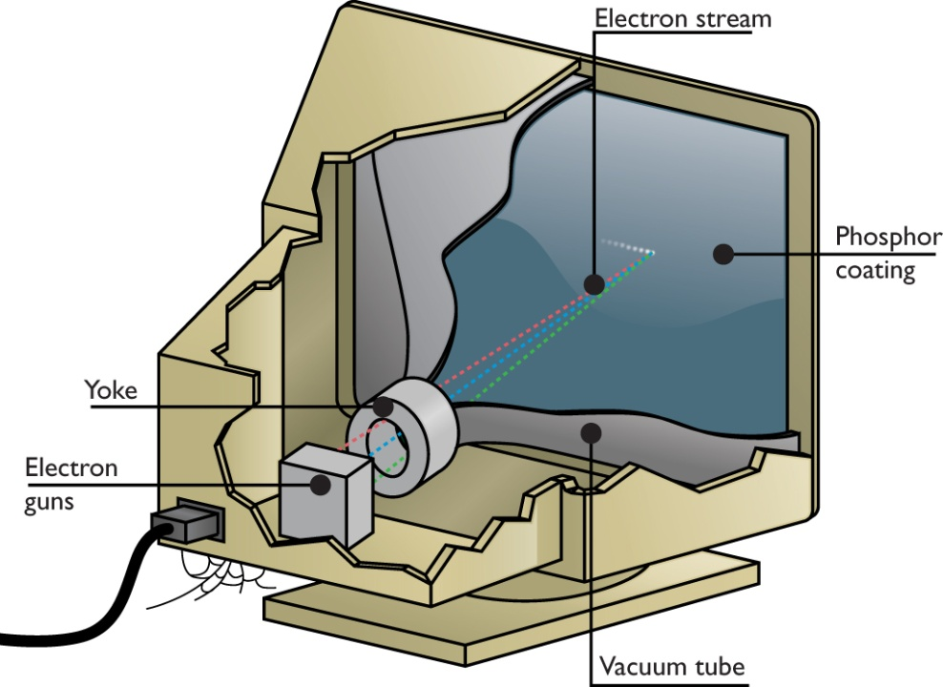
CRT Monitors
Figure 19.2 Electron stream in the CRT

Slide 8
Refresh Rate
Horizontal refresh rate (HRR)
The speed at which the electron beam moves across the screen
Vertical refresh rate (VRR)
The amount of time taken by the monitor to draw the entire screen and get the electron beam back to the start
Refresh rate
The time it takes for the monitor to redraw a whole screen
Notes:
8

Slide 9
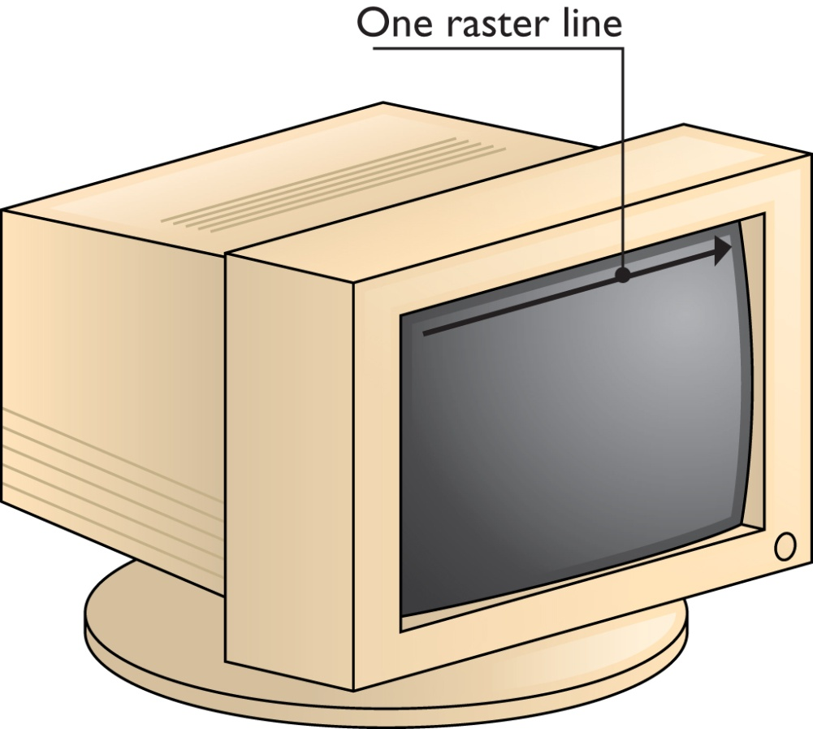
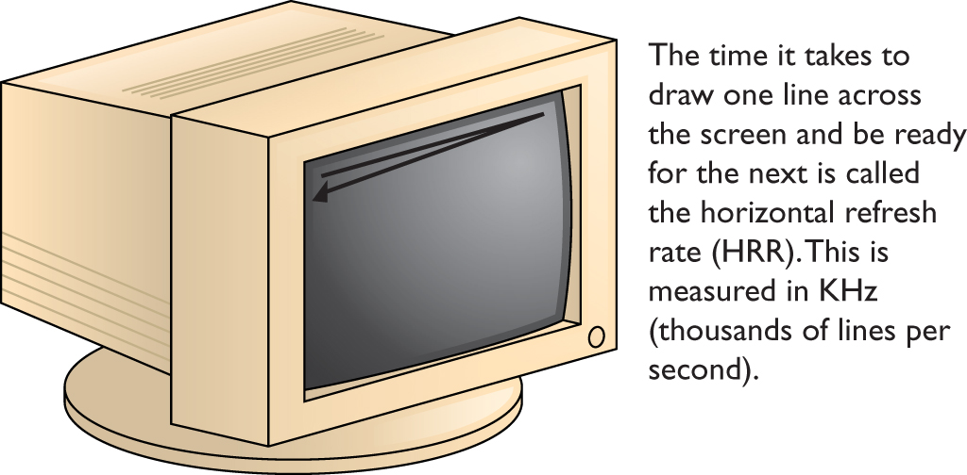
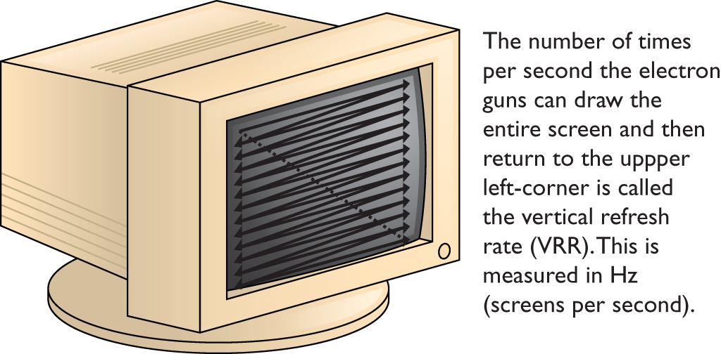
Refresh Rate
Figure 19.3 Electron guns sweep from left to right.
Figure 19.4 Horizontal refresh rate
Figure19.5 Vertical refresh rate

Slide 10
Phosphors and Shadow Mask
Phosphors are dots of phosphorous that glow red, green, or blue when an electron gun sweeps over them.
Evenly distributed over the front of the monitor
Normal CRT had three electron guns: one for each color phosphor.
Shadow mask – a screen that allowed only the proper electron gun to light the proper phosphors.
Individual pieces of the picture are called pixels, from the term picture elements.
Notes:
10

Slide 11

Phosphors and Shadow Mask
Figure 19.6 A monitor is a grid of red, green, and blue phosphors.

Slide 12

Phosphors and Shadow Mask
Figure 19.7 Shadow mask

Slide 13
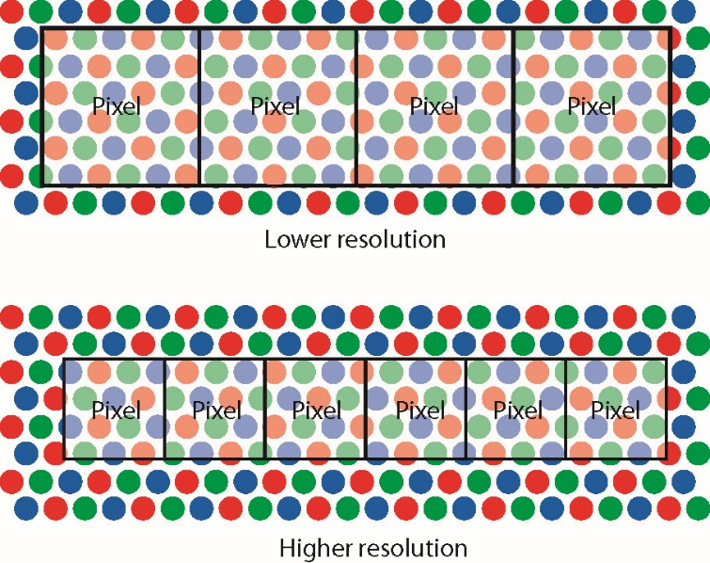
Resolution
Resolution is shown as the number of horizontal pixels times number of vertical pixels
Most resolutions match a 4:3 ratio, called the aspect ratio.
Figure 19.8 Resolution versus pixel size
Notes:
13

Slide 14
LCD Monitors
Liquid crystal displays on today’s computing devices
How LCDs work
Liquid crystals take advantage of the property of polarization.
Liquid crystals are composed of specially formulated liquid.
Liquid is full of long, thin crystals that always orient themselves in the same direction.
The crystals act like a liquid polarized filter.
Notes:
14

Slide 15
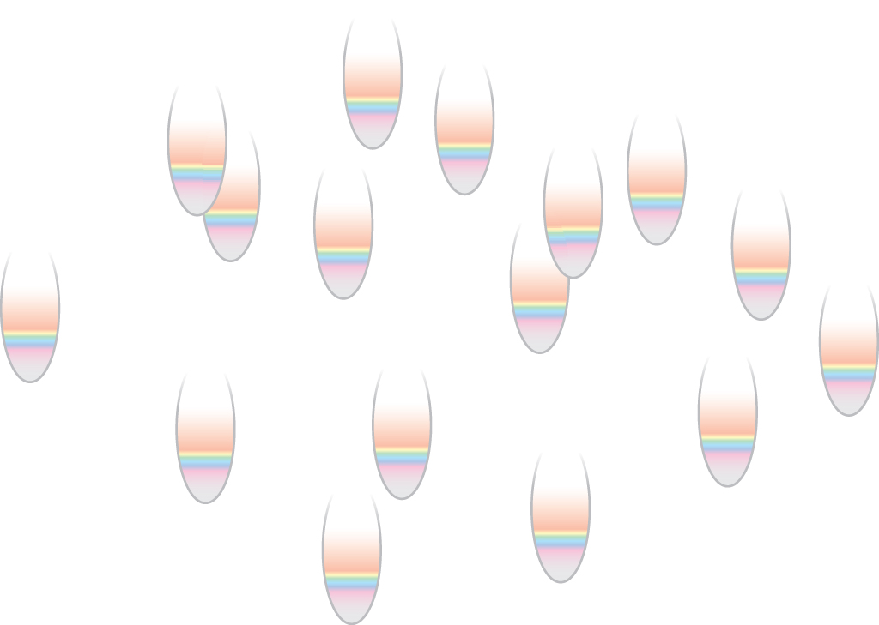
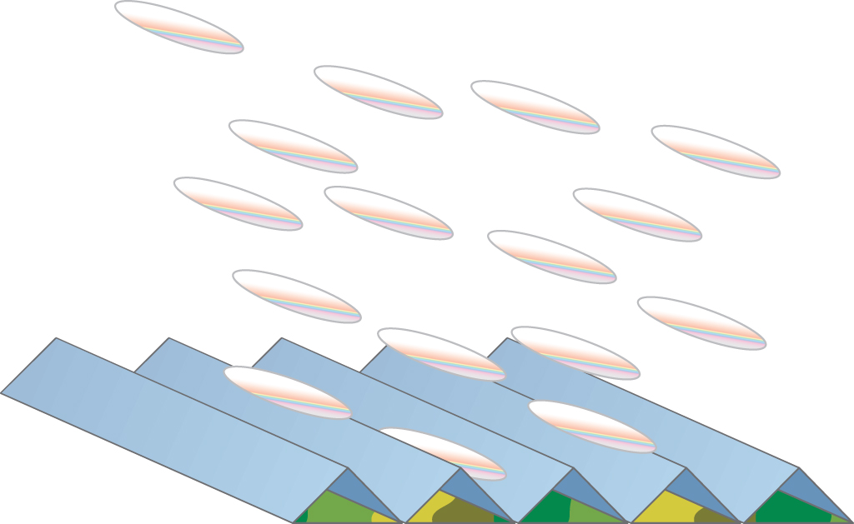
LCD Monitors
Figure 19.9 Waves of similar orientation
Figure 19.10 Liquid crystal molecules tend to line up together.

Slide 16
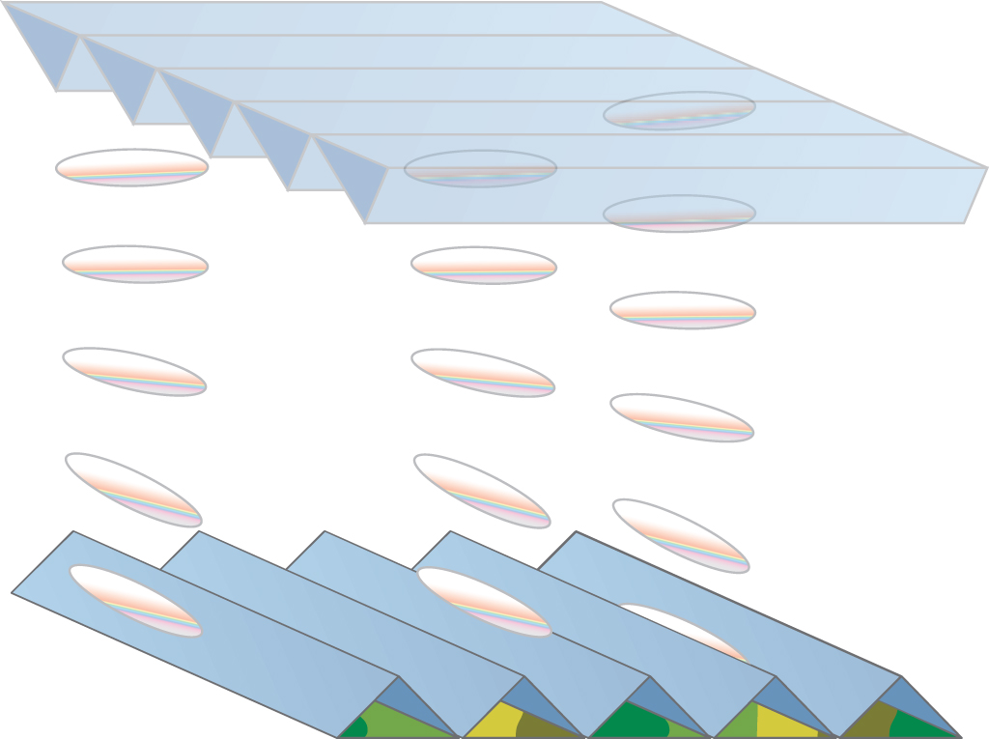
LCD Monitors
If you place two finely grooved surfaces with fine grooves oriented at a 90° angle, the molecules in the middle will try to line up to both sides—creating a nice twist.
Figure 19.11 Liquid crystal molecules twisting
Notes:
16

Slide 17
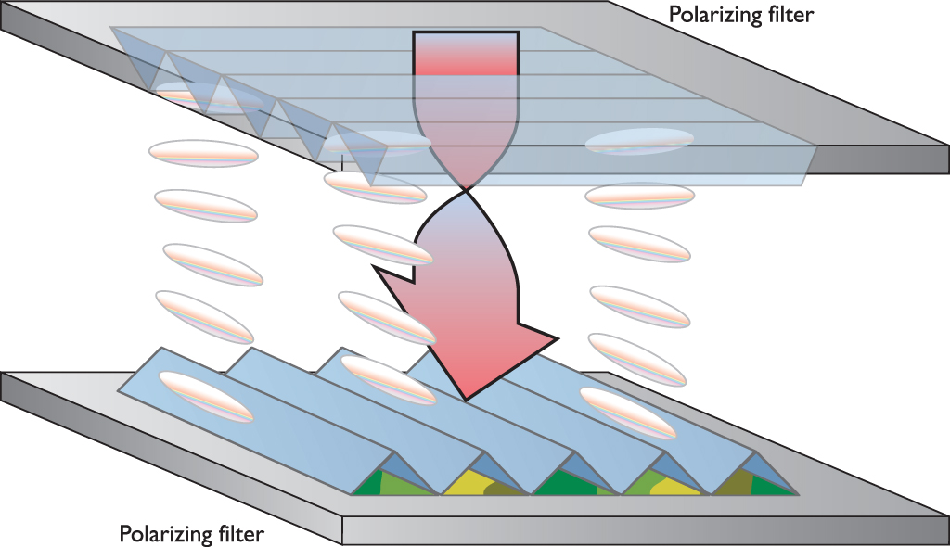
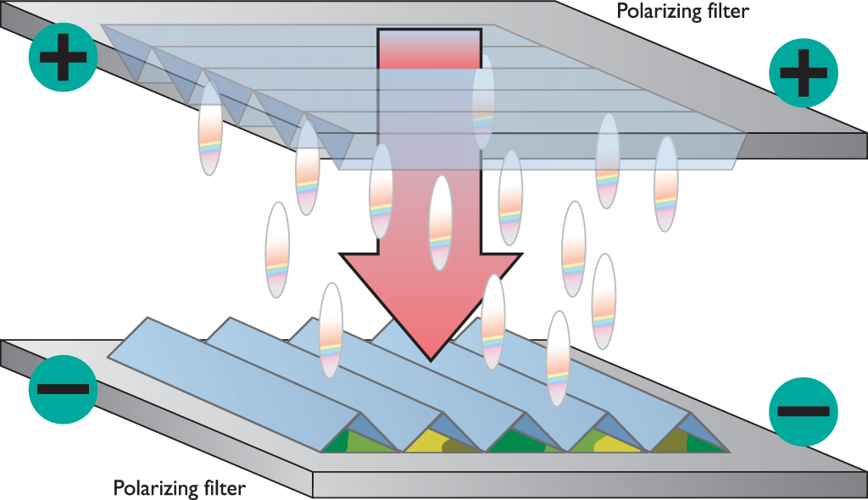
LCD Monitors
With polarizing filters on both sides, the liquid crystal will twist the light and enable it to pass through.
Adding an electrical potential will cause the crystals to try to align to the electrical field.
Figure 19.12 No charge, enabling light to pass
Figure 19.13 Electrical charge, no light is able to pass
Notes:
17

Slide 18
LCD Monitors
A color LCD screen is composed of a large number of tiny liquid crystal molecules (called sub-pixels) arranged in rows and columns between polarizing filters.
A translucent sheet above the sub-pixels is colored red, green, or blue.
Each tiny distinct group of three sub-pixels—one red, one green, and one blue—forms a physical pixel.

Slide 19
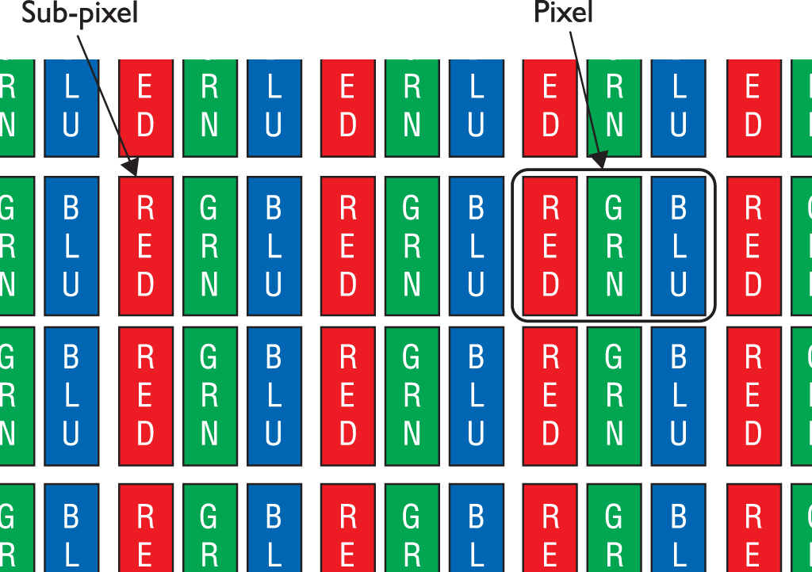
LCD Monitors
Figure 19.14 LCD pixels

Slide 20
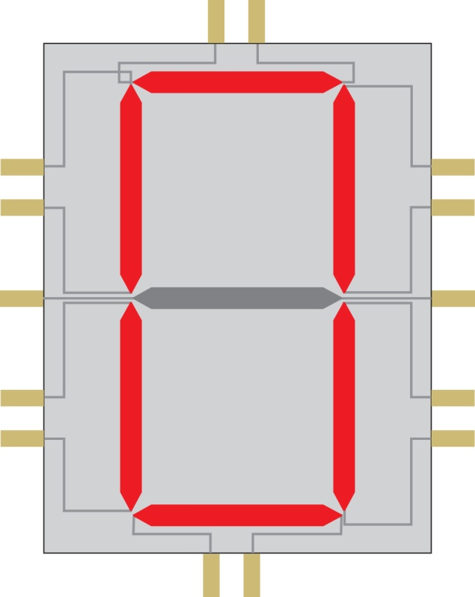
LCD Monitors
Figure 19.15 Single character for static LCD numeric display

Slide 21
LCD Monitors
Early LCD screens used a matrix of wires for charge.
Vertical wires (Y wires) ran to every sub-pixel in the column; horizontal wires (X wires) ran along an entire row of sub-pixels.
A charge is required on both the X wires and the Y wires to light a single sub-pixel.
LCD technology passive matrix gives a slightly blurred image effect.
Dual-scan passive matrix refreshes the screen two lines at a time.
Notes:
21

Slide 22
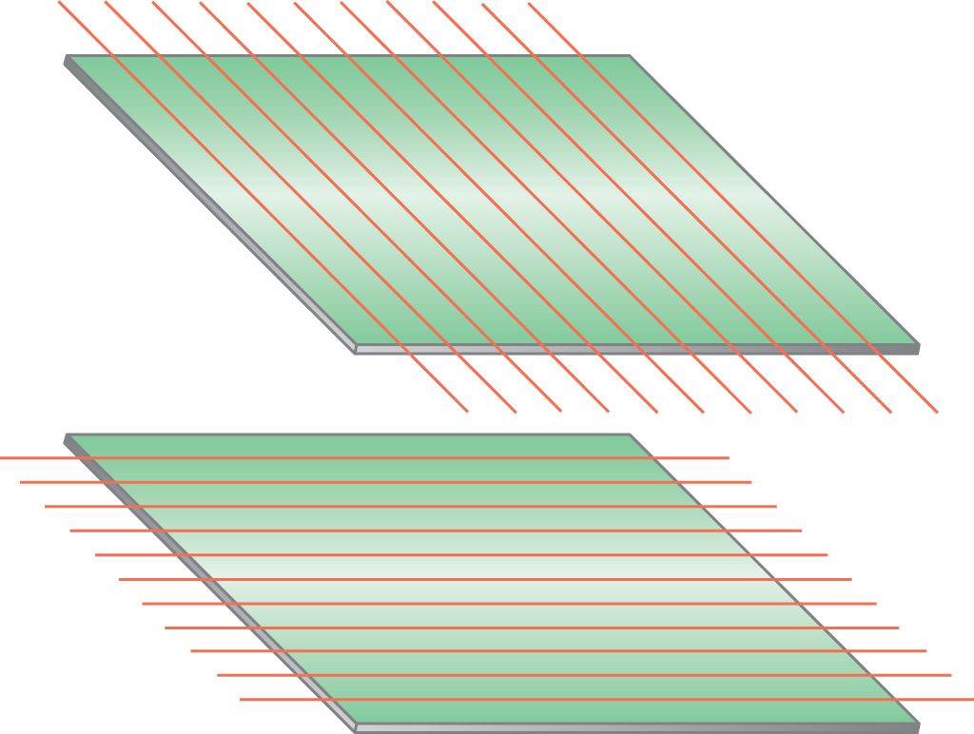
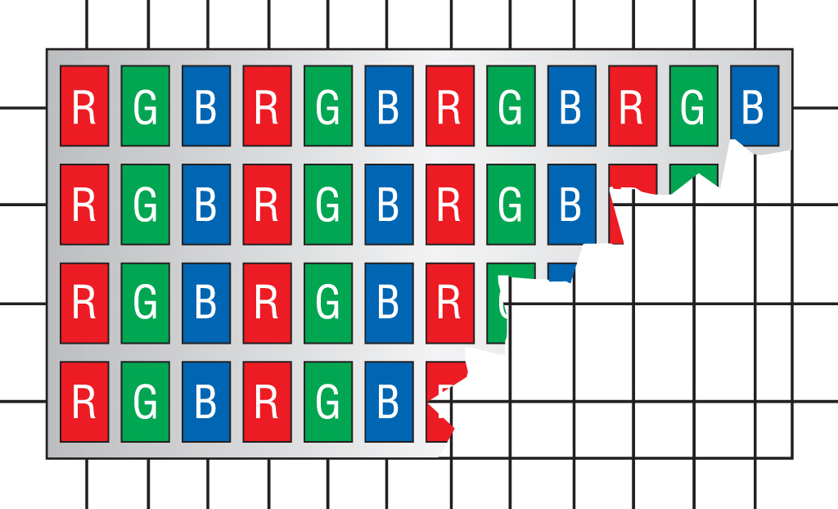
LCD Monitors
Figure 19.16 An LCD matrix of wires
Figure 19.17 Passive matrix display

Slide 23
LCD Monitors
Thin film transistor (TFT) or active matrix technology is used in current LCD monitors.
Uses one or more tiny transistors to control each color dot.
The most common TFT displays use a technology called twisted nematic (TN).
Better TFT displays use a technology called In-Plane Switching (IPS) to create a wider viewing angle and far better color re-creation than TN panels can provide.
Notes:
23

Slide 24
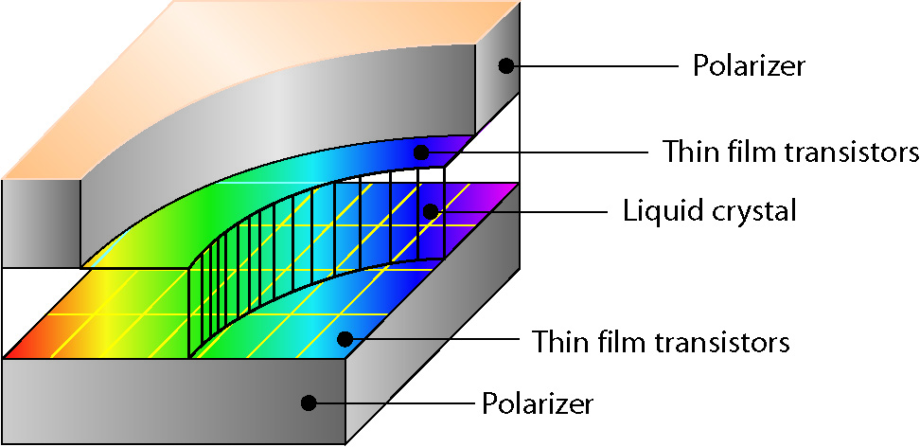
LCD Monitors
Figure 19.18 Active matrix display

Slide 25
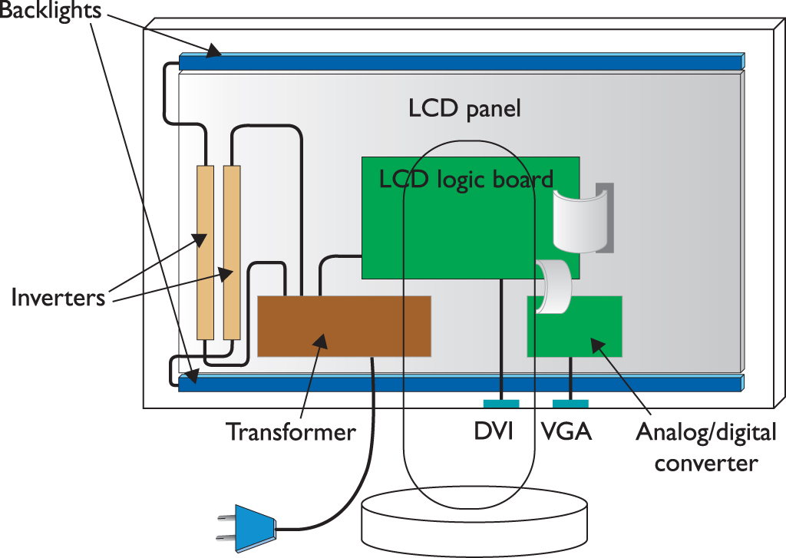
LCD Components
Backlights illuminate the image.
Inverters power the backlights.
Figure 19.19 LCD internals
Notes:
25
Note here the oddity about VGA connectors and the signal changing from analog to digital and back when dealing with VGA to VGA or DVI to VGA. Then note that in practice it’s not so very important until you get to the high end where things like HD video just doesn’t work well with VGA connectors. More on this when you get to “Connections” later in the chapter.
Note: LCD pixels are very different from the pixels in a CRT. A CRT pixel’s size changes depending on the resolution. The pixels in an LCD panel are fixed and cannot be changed.

Slide 26
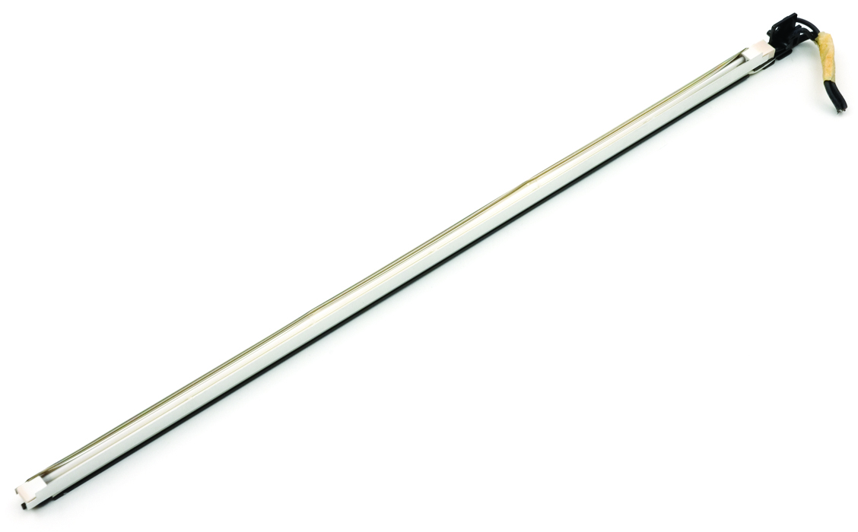
LCD Components
Most LCD backlights use cold cathode fluorescent lamp (CCFL) technology.
Each CCFL backlight needs an inverter.
Figure 19.20 CCFL backlight
Notes:
26
Manufacturers also use several types of light-emitting diode (LED) light for backlighting, either directly illuminating pixels from behind or flooding the panel from the edges of the bezel. Manufacturers have rebranded LCD monitors that use LEDs for backlighting as LED monitors.

Slide 27
LED Monitors
Manufacturers also use several types of light-emitting diode (LED) light for backlighting, either directly illuminating pixels from behind or flooding the panel from the edges of the bezel.
Directly illuminating pixels from behind produces outstanding contrast and color
Costs a lot more than the edge types
LED monitors are LCD monitors that use LEDs for backlighting.

Slide 28
LCD Resolution
All LCD monitors have a native resolution.
Display sharpest picture when set to this resolution
LCD panels cannot display more than their pixel limitation.
When set to lower resolutions, image quality is severely degraded.
LCD uses an edge-blurring technique called anti-aliasing to soften jagged corners of the pixels.
Notes:
28

Slide 29
Brightness and Response Rate
Brightness
Determined by backlight
Measured in nits (100 to 1000 with the average at 300)
Response rate
Amount of time it takes for all the sub-pixels on the panel to go from pure black to pure white and back again
Ghosting problems exhibited by low-end LCDs (20–25 ms)
Notes:
29
Note: One nit equals one candela/m². One candela is roughly equal to the amount of light created by a candle.

Slide 30
Refresh Rate and Contrast Ratio
Refresh rate
For an LCD monitor, this refers to how often a screen can change or update completely.
The standard for the industry is 60 Hz.
Contrast ratio
Contrast ratio is the difference between lightest and darkest spots that the monitor can display.
Dynamic contrast ratio measures the difference between a full-on, all-white screen, and a full-off, all-black screen.

Slide 31
Comparing LCDs
Size and native resolution are top considerations.
Panel technology and backlight can impact overall quality of display as well as price.
CompTIAA+ objectives say “fluorescent vs. LED backlighting.”

Slide 32
Projectors
Projectors enable display of computer images to an audience.
A rearview projector is self-enclosed and shoots an image onto a screen from the rear.
A front-view projector shoots the image out the front and requires a screen at the proper distance.
Notes:
32

Slide 33
Projector Technologies
LCD projectors are light and very inexpensive compared to the older CRT technology.
Digital Light Processing (DLP) technology from Texas Instruments uses a single processor and an array of tiny mirrors to project a front-view image.
Produces a softer image than LCD

Slide 34
Lumens, Throw, and Lamps
Lumens
A lumen is the amount of light provided by a light source.
Higher lumens equates to a brighter picture.
Throw
The size of an image at a certain distance
Related to aspect ratio
Lamps
Get very hot
Expensive—typically a few hundred dollars
Notes:
34

Slide 35
Plasma Displays
Plasma display panels (PDPs)
A popular technology for displaying movies
Compete directly with LCD screens for flat-panel space
Offer a wider viewing angle
Higher-quality image than the typical LCD
Cost less
Disadvantages of PDPs as compared to LCDs
Weigh a lot more
Consume much more electricity

Slide 36
Plasma Displays
Issues that make PDPs a bad choice for PC use
Burn-in is the tendency for a screen to leave a “ghost” image even after the image is off the screen.
Plasma TV makers have virtually eliminated burn-in.
Even the latest plasma displays are subject to burn-in when used as PC displays.
Overscan occurs when the TV blows up the image, cropping off the edges of the picture.
Can cut off items such as the taskbar on a PC display.

Slide 37
Common Features—Connections
Many monitors use a 15-pin, three-row, D-type connector (or VGA connector) and a power plug.
Connector also called HD15 for high density
Controlling a CRT requires an analog signal from the video card.
Video cards include a special chip called the random access memory digital-to-analog converter (RAMDAC).
RAMDAC takes the digital signal from the video card and turns it into an analog signal for the analog CRT.
Notes:
37

Slide 38
Common Features—Connections
LCD monitors use digital signals.
New LCDs (and video cards) feature the digital video interface (DVI) standard.
DVI includes three different connectors: DVI-D, DVI-A, and DVI-A/D (or DVI-I).
DVI-D and DVI-I connectors have two varieties:
Single-link DVI has a maximum bandwidth of 165 MHz.
Dual-link DVI has higher throughput and can support higher resolutions.
Notes:
38
Controlling a CRT requires an analog signal from the video card, meaning a signal that rises and falls in waves—LCDs and computers use digital signals (on or off, one or zero).

Slide 39
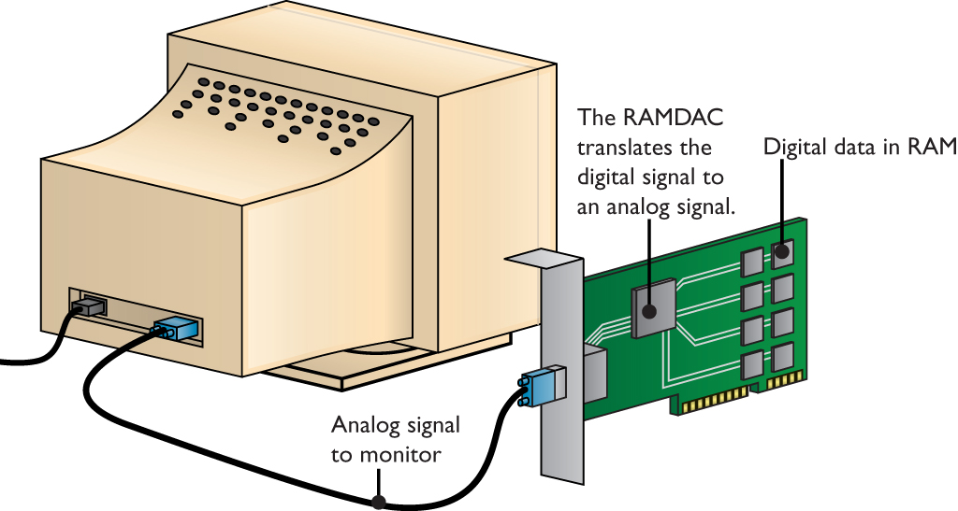
Common Features—Connections
Figure 19.27 An analog signal sent to a CRT monitor

Slide 40
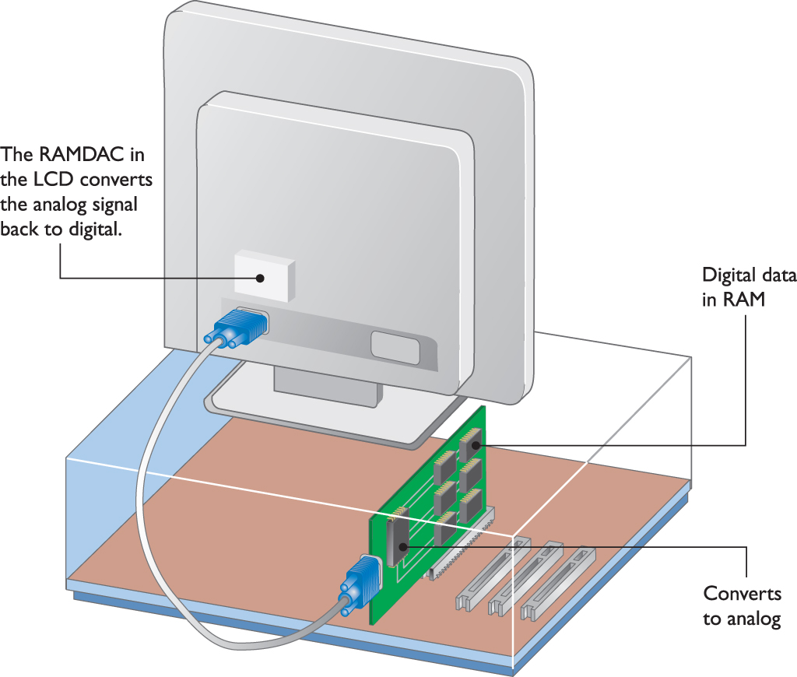
Common Features—Connections
Figure 19.28 Converting analog back to digital on the LCD

Slide 41
Common Features—Adjustments
Controls
On/off button
Brightness/contrast button
Onboard menu system
Two main menu functions
Physical screen adjustments
Color adjustments
Notes:
41

Slide 42
Display Adapters
The video card handles the video chores within computing devices.
The graphics processor needs RAM.
Graphics processor requires fast connectivity between it, the CPU, and system RAM.
Often the display adapter is an expansion card that plugs into the motherboard.
Many new systems have the display adapter circuitry built into the motherboard.
Notes:
42

Slide 43
Display Adapters
Aspects that define a video card include:
Display modes
Motherboard slot
Graphics processor circuitry
Video memory
Integrated GPUs
Connections
Notes:
43

Slide 44
Modes
Text video cards display only the 256 ASCII characters.
Older systems displayed just 80 chars/row and 24 rows—only 1920 bytes of RAM needed.
Graphics video cards can turn any pixel on/off.
Resolution of 320 × 200 pixels requires 8 KB.
To add color, add multiple bits.
8 bits = 256 colors; 24 bits = 16.7 million colors.
Color depth is represented as bits (e.g., color depth of 24 bits) – techs talk in terms of bits, not colors.
Notes:
44
The video card must have sufficient RAM to support each combination of color depth and resolution.

Slide 45
Modes
Color depth is represented as bits.
Color depth of 24 bits
Any single combination of resolution and color depth you set for your system is called a mode.
Number of colors | Number of bits
2 colors | 1 bit (mono)
4 colors | 2 bits
16 colors | 4 bits
256 colors | 8 bits
64 K colors | 16 bits
16.7 million colors | 24 bits
Notes:
45
Know your color depths both in terms of bits and numbers of colors!

Slide 46
VGA
Video graphics array (VGA) standard
Analog video signal instead of digital
Minimum display requirement typically 640 × 480 pixels and 16 colors
Beyond VGA
4K Ultra HD
Resolution twice the width and twice the height of HD in one panel
5K Ultra HD
Both 4K and 5K – 16:9 aspect ratio

Slide 47
Motherboard Slot
Ways that display adapters connect to a motherboard
PCI
AGP
PCIe
Motherboard with display adapter built-in

Slide 48
Motherboard Slot
PCI
800 × 600 with a refresh of 70 Hz at 8 bits (256 colors) requires 33.6 MBps bandwidth.
24 bits (16.7 million colors) requires 100.8 MBps.
Not enough bandwidth is available on a shared PCI bus.
AGP (accelerated graphics port)
Developed by Intel
Dedicated to video
Only found on early systems
Notes:
48

Slide 49
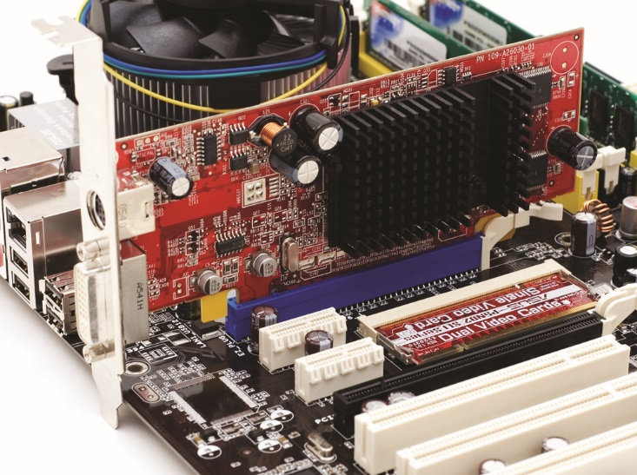
Motherboard Slot
PCI Express (PCIe) interface developed to replace PCI
Also replaced AGP
Figure 19.34 PCIe video card connected in PCIe slot
Notes:
49

Slide 50
Graphics Processor
A graphics processing unit (GPU) is a device that processes video.
Most GPUs found on video cards are made by:
NVIDIA
AMD
Intel
Choice of graphics processor is the single most important decision in buying a video card.
Notes:
50
Intel primarily focuses on GPUs built into motherboards.

Slide 51
Video Memory
Video RAM constantly updates to reflect every change that takes place on screen.
Three bottlenecks:
Data throughput speed
Access speed
Simple capacity
Overcome bottlenecks in three ways:
Wider bus between video RAM and video processor
Specialized super-fast RAM
More RAM
Notes:
51
Gaming requires high-end video cards for the best effects:
3-D textures are bitmap graphics applied to 3-D wireframes like skin over bones.
Applying a premade texture to a wireframe drawing is called rendering.
Textures are not large but games may require hundreds.
To store these, more RAM is needed. Advanced 3-D video cards may have up to 768 MB of RAM.
Video display memory ranges from 32 bits to 256 bits wide.

Slide 52
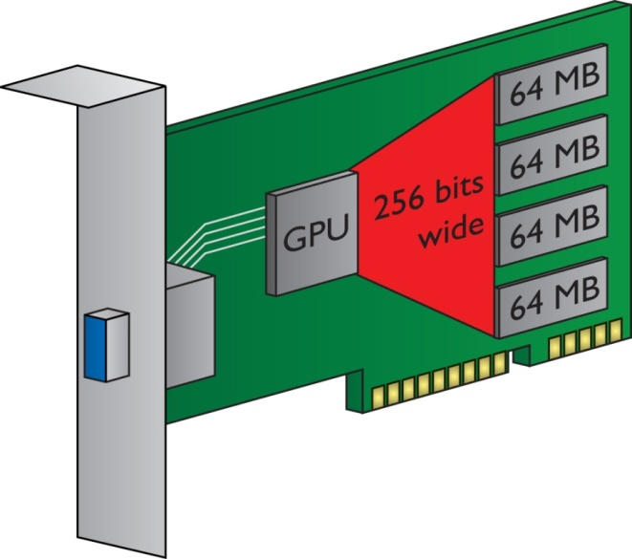
Video Memory
Figure 19.36 Wide path between video processor and video RAM
Notes:
52

Slide 53
Integrated GPUs
A lot of current motherboards have or can support integrated GPUs.
Motherboard GPU can be a separate chip attached to the motherboard, or it can be built into the Northbridge chip.

Slide 54
Integrated GPUs
AMD, Intel, and NVIDIA make CPUs with integrated GPUs that vary in performance and combination.
A single AMD Accelerated Processing Unit (APU) chip integrates:
Two to four CPU cores
A memory controller that supports DDR3 for system memory
Cache memory
A GPU that can handle advanced 3-D graphics

Slide 55
Connector Types and Associated Cables
Video cards offer a variety of connections.
Standard connections include:
VGA
DVI
DB-15
DisplayPort
Thunderbolt
HDMI (including Mini- and Micro- variants)
Notes:
Most DVI connections on video cards these days natively support analog signals. You can use a simple DVI-to-VGA adapter, for example, for connecting a VGA cable to a video card.

Slide 56
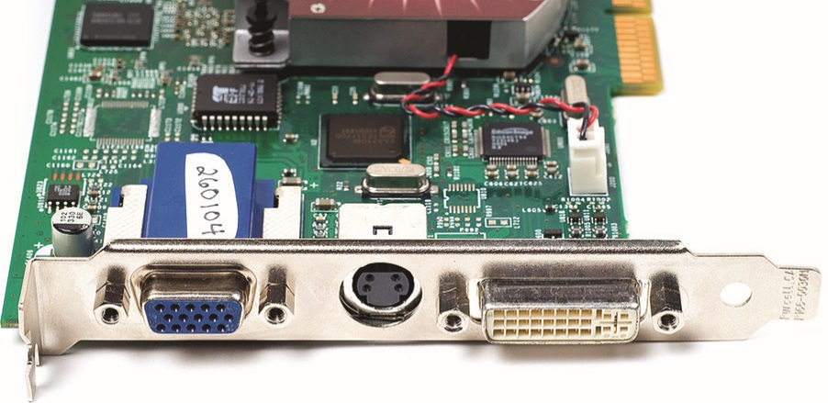
Connector Types and Associated Cables
Video cards offer other connector types for connecting to things like television sets, camcorders, and other multimedia devices:
RCA
BNC
Mini-DIN
Figure 19.37 Video card connectors: VGA, S-video, and DVI-I

Slide 57
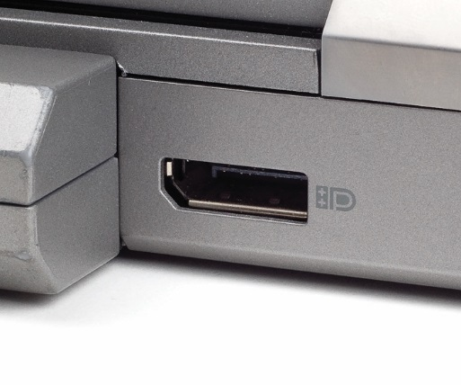
Connector Types and Associated Cables
For standard monitors
Most DVI connections on video cards these days natively support analog signals.
Apple Mac desktop models use a DisplayPort connection for the monitor.
More recent Apple offerings use a Thunderbolt connection.
Figure 19.38 DisplayPort jack
Notes:
57

Slide 58
Connector Types and Associated Cables
For multimedia devices
Composite connector provides a video signal through a single cable that plugs into a standard RCA jack.
A component adapter provides a split signal, red, green, and blue (RGB).
The best connections for outputting to television are the High Definition Multimedia Interface (HDMI) connectors.

Slide 59
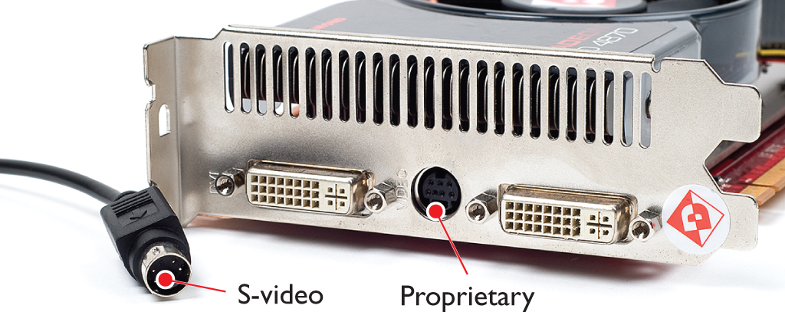
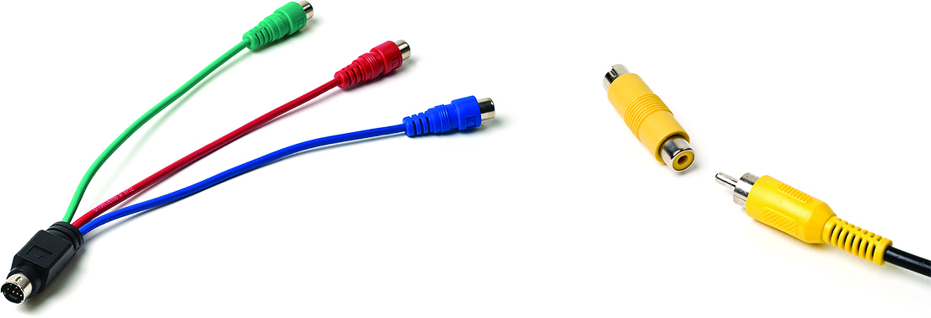
Connector Types and Associated Cables
Figure 19.40 S-video and proprietary round connectors
Figure 19.41 Composite and component connection options

Slide 60
Connector Types and Associated Cables
Adapters and converters
Manufacturers provide many converters
DVI to HDMI
Thunderbolt to DVI
HDMI to VGA
DisplayPort to DVI
DisplayPort to HDMI

Slide 61
Installing and Configuring Video
Once you’ve decided on the features and price for a new video card, you need to install them into your system.
Possible physical installation issues:
Long cards, proximity of the nearest expansion card, and presence of power connectors
Additional considerations:
Be aware of airflow around the video card.
Mid-range to high-end video cards require at least one additional PCI power connector.

Slide 62
Software
Configuring video software is a two-step process:
Load drivers for the video card.
Open the Control Panel and go to the Display applet (Windows 7/8/8.1/10) or Personalization applet (Windows Vista) to make your adjustments.
Notes:
62

Slide 63
Software
Drivers
Install the driver.
Make sure the driver is up to date.
Check the manufacturer’s website.
Notes:
63

Slide 64
Using the Display and Personalization Applets
Configuring display settings:
Display applet and Personalization applet
These Control Panel applets enable you to make changes that affect many aspects of visual output:
Adjust resolution.
Adjust brightness.
Calibrate color.
Change display settings.
Project to a second screen.
Adjust ClearType text.

Slide 65
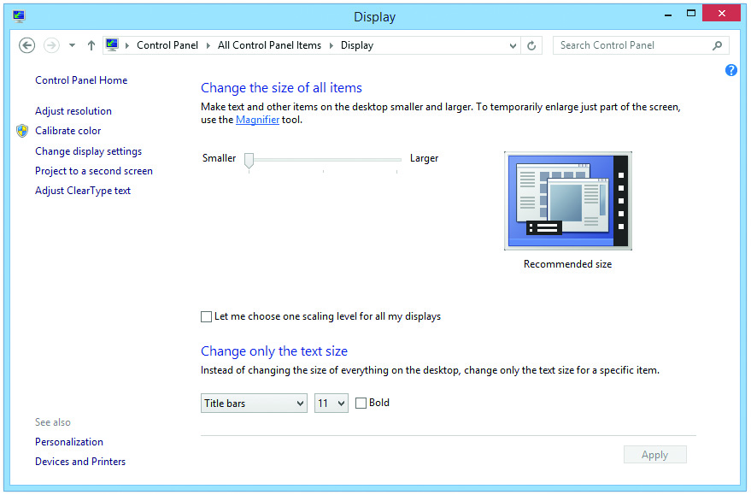
Using the Display and Personalization Applets
Figure 19.46 Display applet in Windows 8.1

Slide 66
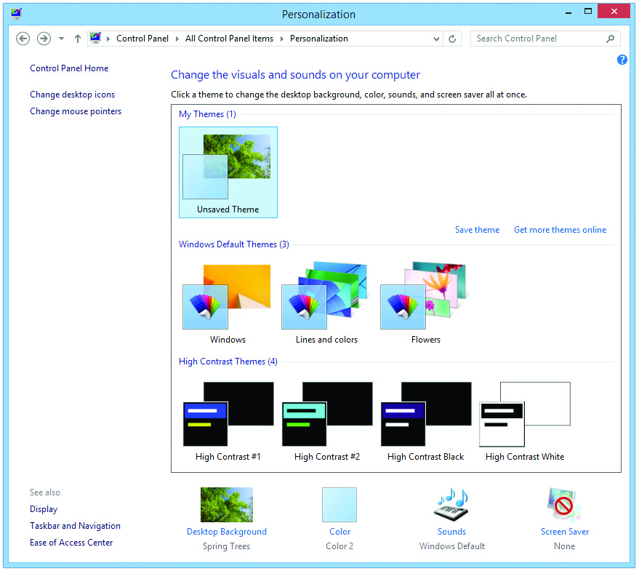
Using the Display and Personalization Applets
Figure 19.47 Personalization applet in Windows 8.1

Slide 67
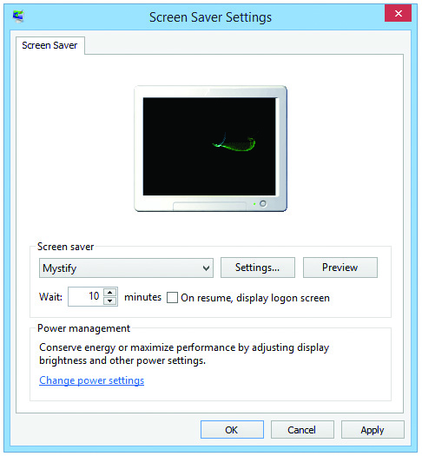
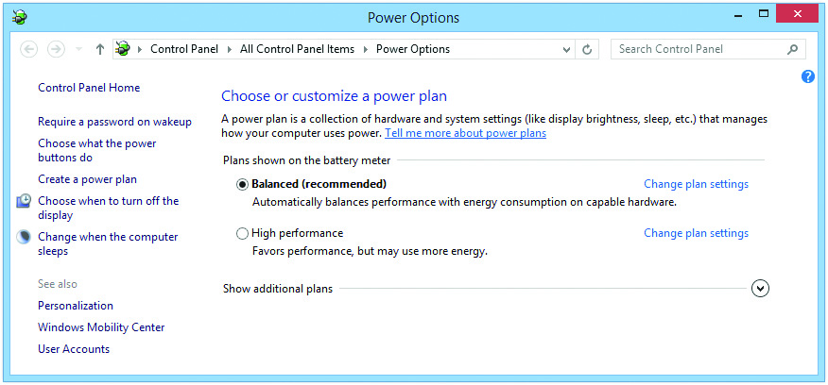
Using the Display and Personalization Applets
Screen Saver option goes beyond just displaying a nice image on the screen.
Can also configure display power management
Figure 19.49 Screen Saver Settings in Windows 8.1
Figure 19.50 Power Options applet in Windows 8.1
Notes:
67

Slide 68
Using the Display and Personalization Applets
Multiple monitors
Display applet enables you to modify how multiple monitors function.
There are two ways to set up multiple monitors:
Plug in two or more video cards.
Use a single video card that supports multiple monitors.
Under Advanced Settings, the Adapter tab gives detailed information about the video card, including:
The amount of video memory, the graphics processor, and the BIOS information

Slide 69
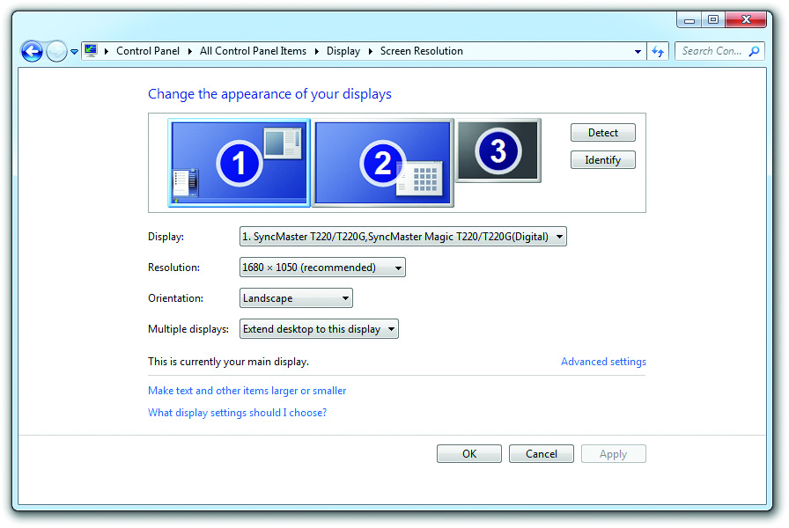
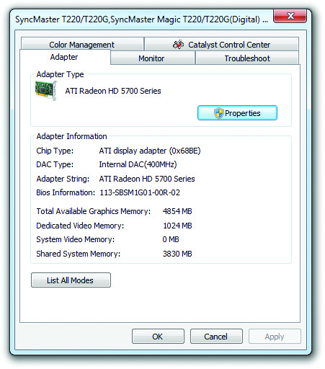
Using the Display and Personalization Applets
Figure 19.52 Enabling multiple monitors
Figure 19.53 Advanced video settings, Adapter tab

Slide 70
Using the Display and Personalization Applets
Most video cards add their own tab to the Advanced dialog box.
Settings vary by card model and driver version.
Settings you might see include:
Color correction
Rotation
Some LCD monitors can rotate to portrait mode.
Modes
These advanced settings are used to finely tweak the monitor.

Slide 71
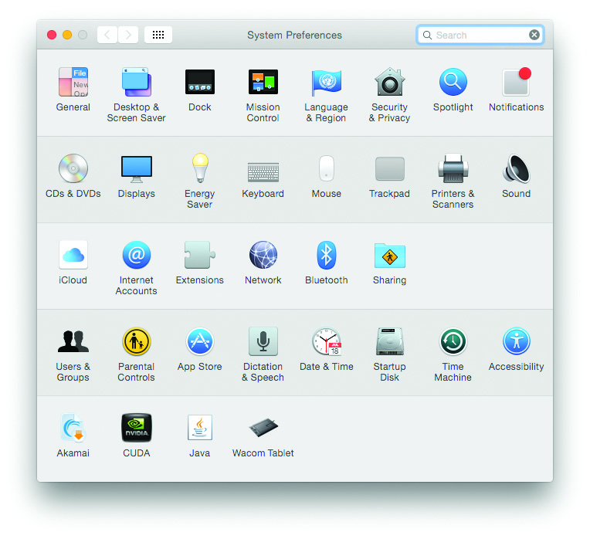
Display Options in Mac OS X
Mac OS X
Under System Preferences
Figure 19.56 System Preferences in Mac OS X

Slide 72
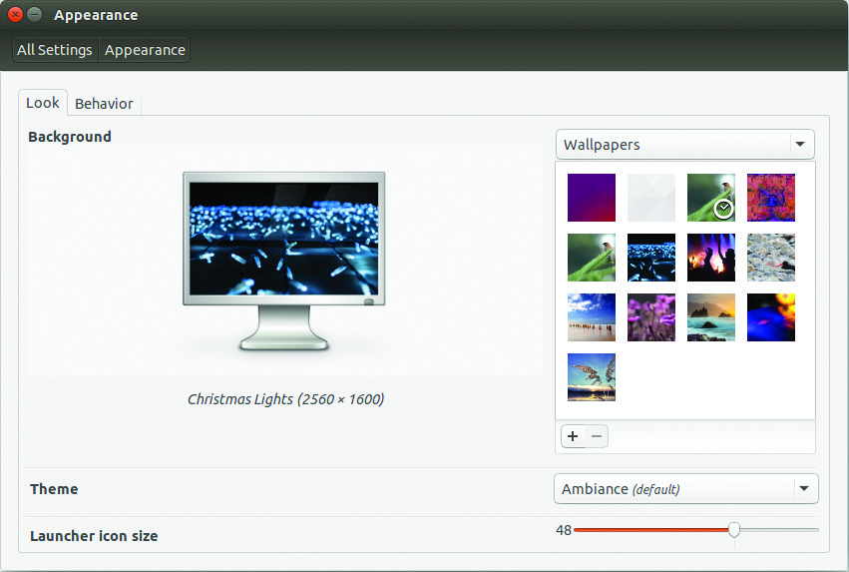
Display Options in Linux
Linux
Under System Settings
Figure 19.58 Appearance applet in System Settings

Slide 73
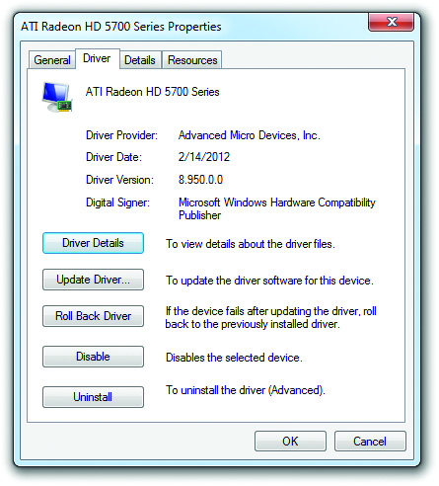
Working with Drivers
You need to know how to work with video drivers from within the Display and Personalization applets.
Update driver
Roll back driver
Uninstall driver
Figure 19.59 Adapter Properties dialog box
Notes:
73

Slide 74
3-D Graphics
3-D graphics attempts to create images with the same depth and texture as objects seen in the real world.
3-D technologies are used in 3-D gaming and other applications such as computer-aided design (CAD).
First-person shooters (FPSs) such as Wolfenstein 3D started move to 3-D PC gaming.
Notes:
74

Slide 75
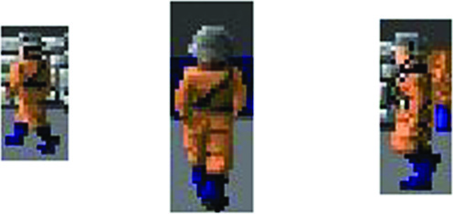
3-D Graphics
Early 3-D games used sprites.
A sprite is a bitmap graphic moved around on the screen.
Each figure had a limited number of sprites or angles of view.
Figure 19.61 Each figure had a
limited number of sprites.
Notes:
75

Slide 76
3-D Graphics
The second generation produced 3-D objects through a process called rendering.
Objects are composed of a group of points or vertices.
Vertices were connected with lines.
Edges form triangles that create polygons.
The last step is adding image files called textures.
Notes:
76

Slide 77
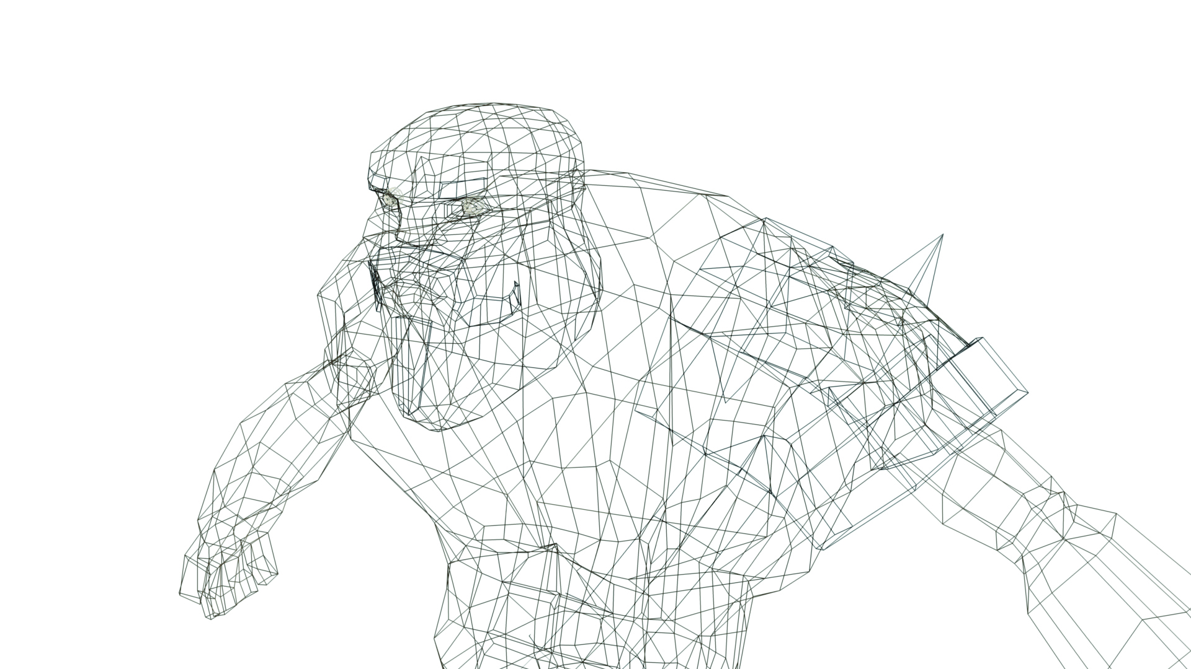
3-D Graphics
Figure 19.62 Vertices for a video game warrior

Slide 78

3-D Graphics
Figure 19.63 Connected vertices forming polygons on a 3-D character

Slide 79

3-D Graphics
Figure 19.64 Video game warrior with textures added

Slide 80
3-D Video Cards
Graphics processing units needed to evolve.
Video card instructions standards manifested themselves into a series of application programming interfaces (APIs).
An API is a library of commands that programmers use.
Several APIs have been developed over the years, with two clear winners among all of them:
OpenGL standard – developed for UNIX
DirectX – created by Microsoft
Notes:
80

Slide 81
DirectX and Video Cards
DirectX provides direct access to hardware and is used for more than just video.
DirectDraw for 2-D graphics
Direct3D for 3-D graphics
DirectInput for joysticks and game controllers
DirectSound for waveforms
DirectMusic for MIDI devices
DirectPlay for multiplayer games
DirectShow for video and presentation devices
Notes:
81

Slide 82
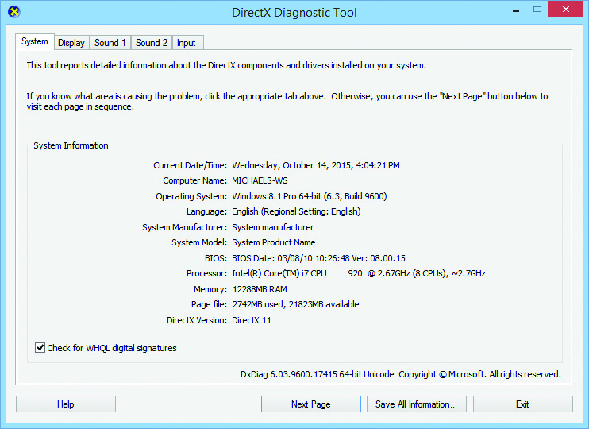
DirectX and Video Cards
Microsoft constantly adds and tweaks DirectX.
To verify DirectX, use the DirectX Diagnostic Tool (dxdiag).
Figure 19.65 The DirectX Diagnostic Tool
Notes:
82

Slide 83
Troubleshooting Video
Troubleshooting video cards/drivers
Vast majority of problems are due to:
Improper or corrupt drivers
Incorrect settings
Reboot into Safe mode and roll back or delete driver.
Hardware problems may involve:
The fan
RAM
Excessive heat can create various problems.
The computer could shut down.
The screen may display bizarre artifacts or distorted images.
Notes:
83
Excessive heat inside the case (even with the video card fan running) can cause issues, such as a simple shutdown or screen distortion. Check fans and clean out dust from the PC.

Slide 84
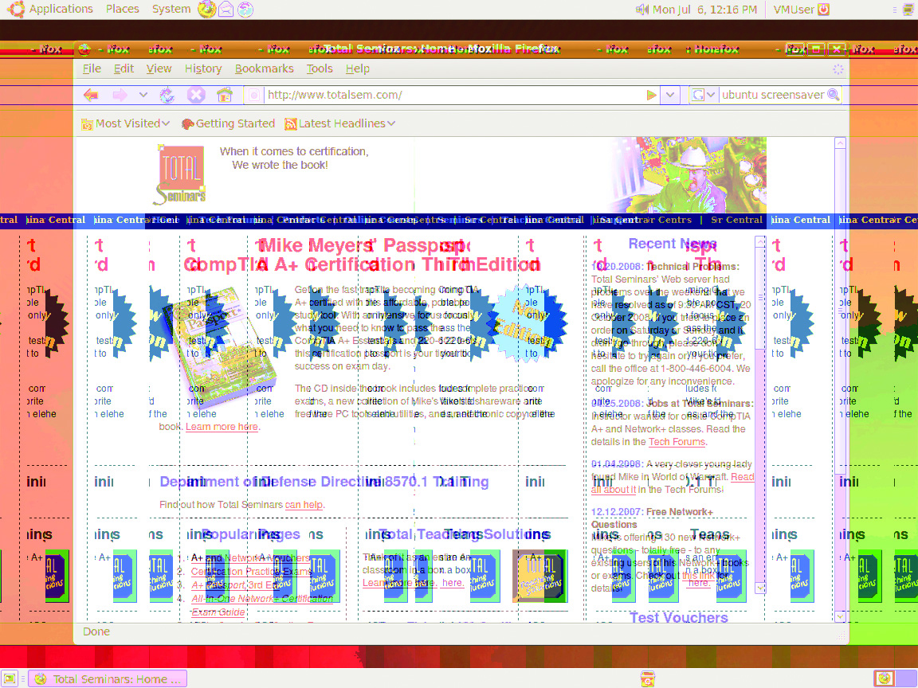
Troubleshooting Video
Figure 19.66 Serious video problem

Slide 85
Troubleshooting Monitors
There are inherent dangers due to high-frequency and high-voltage power required by monitors.
Your goal is to determine if a problem is in one these three categories:
Common monitor problems
External adjustments
Internal adjustments
Notes:
85

Slide 86
Common Monitor Problems
Ghosting, streaking, and /or fuzzy vertical edges
Check the cable connections and the cable itself.
Missing color
Check cable for breaks or bent pins; check monitor adjustments.
Loss of brightness
Monitors lose brightness with age, so use power-management functions.
Internal adjustments may be required.
Notes:
86

Slide 87
Common Monitor Problems
LCD monitor may have bad pixels.
Dead pixel, lit pixel, or stuck pixel
A flickering image on the LCD may be caused by an inexpensive panel with too much light bleed or a dying CCFL backlight.
A dim image points to a dead or dying backlight.
If the LCD goes dark with a faint image seen under bright lights, the problem is a lost backlight or inverter.
A hissing noise from the LCD indicates a failing inverter.
Notes:
87

Slide 88
Cleaning Monitors
Antistatic monitor wipes or antistatic cloths should be used for cleaning the monitor.
Do not use window cleaners.
Avoid commercial cleaning solutions on LCD screens.
Notes:
88

Slide 89
Privacy With Multiple Monitors
Privacy screens (privacy/antiglare filters) are available from vendors.
Stop wide-angle viewing of the screen.
Drop the glare.

Slide 90
Changing Technologies
Curved LCD panels
Curved panels, according to the manufacturers, make the viewing experience far more 3-D like and more immersive.
The panels cut down on glare and increase the viewing angle.
3-D headsets
3-D headsets put the “monitor” in immersive wraparound gear promise essentially virtual reality.

Slide 91


Slide 92
Summary
Explain how video displays work
Select the proper video card
Install and configure video
Troubleshoot basic video problems

Slide 93


